Slide 1
Topic 3 Membership Management System
Member:
Iu Cheuk Ying / Leung Wai Yin / Ng Wing YI / Wong Lok Yi

Slide 2
Purpose
1. Node. Js
2. MongoDB
3. HandelBars HBS

Slide 3
Class diagram

Slide 4
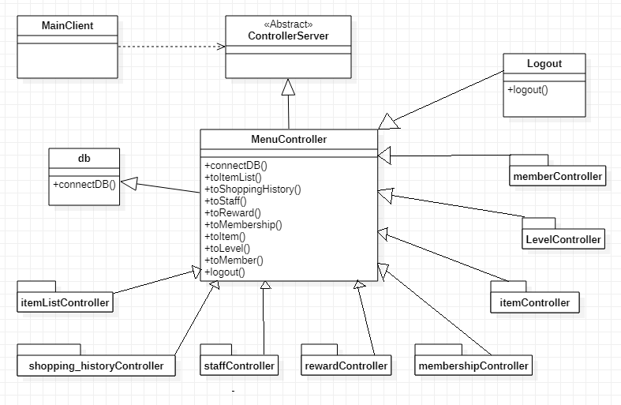
Menu Controller – Strategy pattern

Slide 5
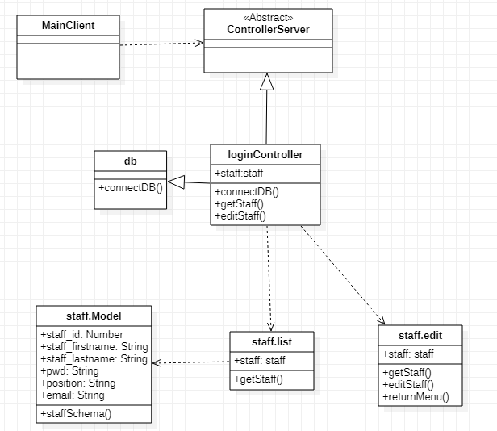
Staff Controller – Adapter pattern

Slide 6
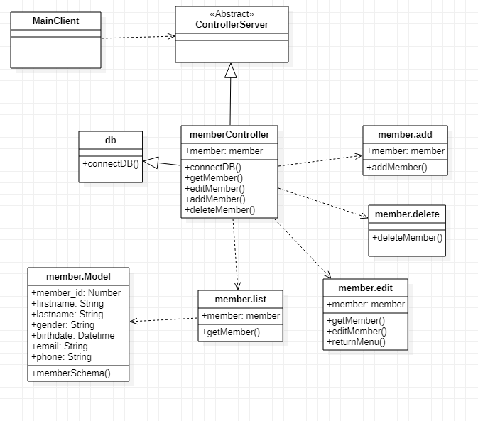
Member Controller – Adapter pattern

Slide 7
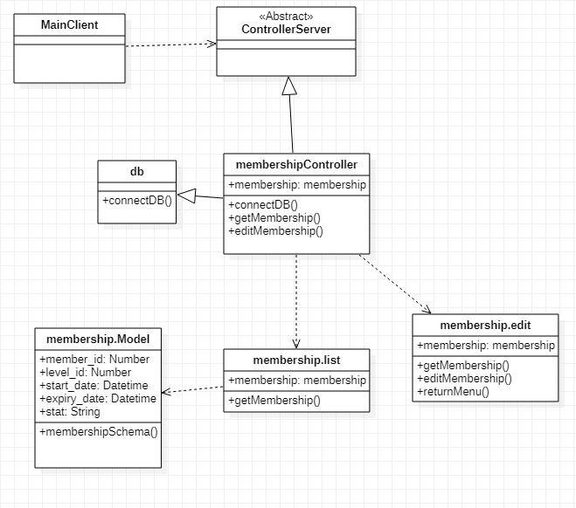
Membership Controller – Adapter pattern

Slide 8
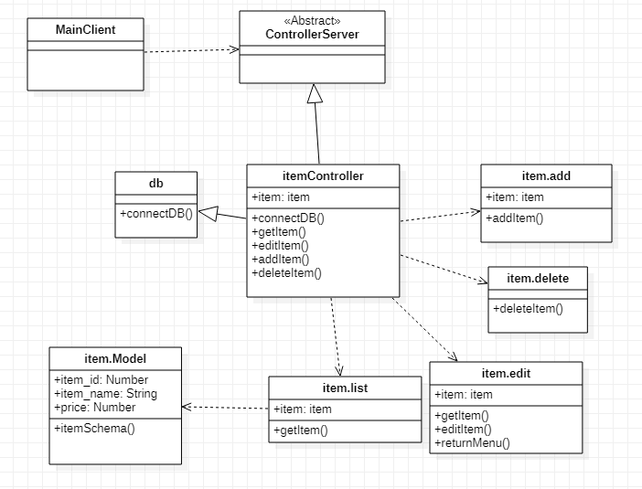
Item Controller – Adapter pattern

Slide 9
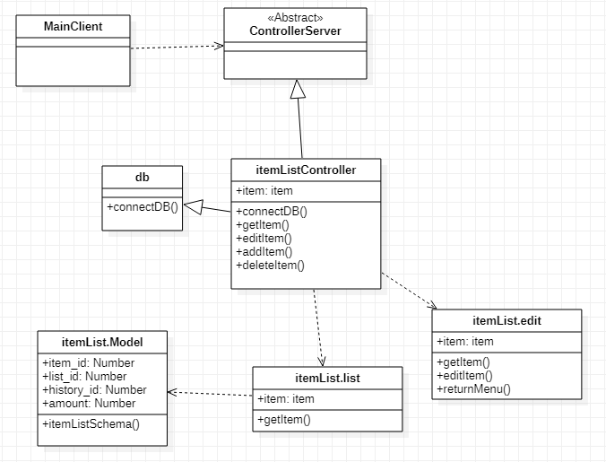
Item List Controller – Adapter pattern

Slide 10
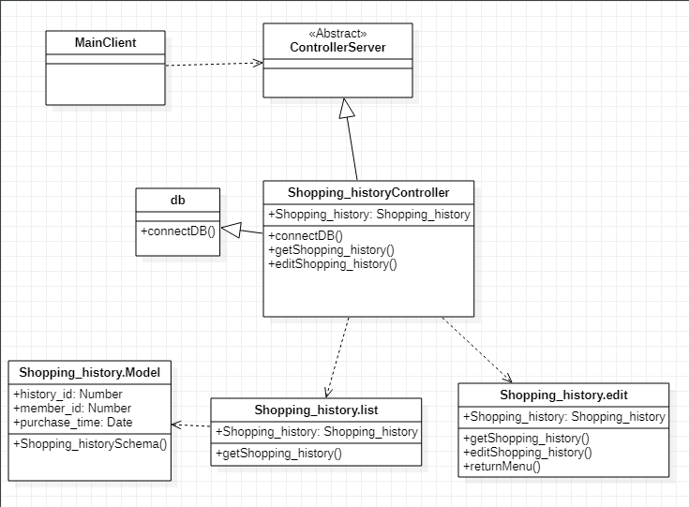
Shopping History Controller – Adapter pattern

Slide 11
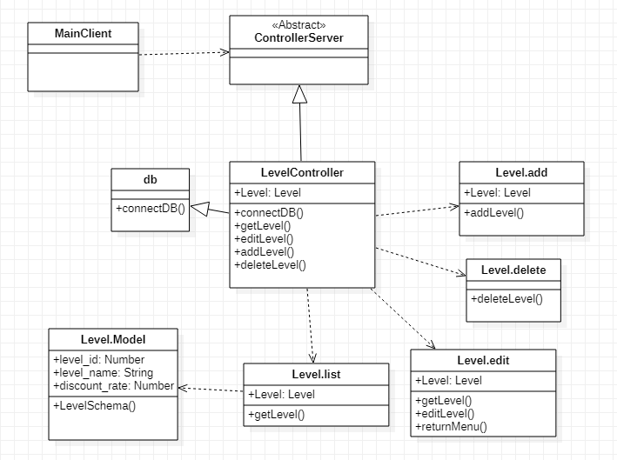
Level Controller – Adapter pattern

Slide 12
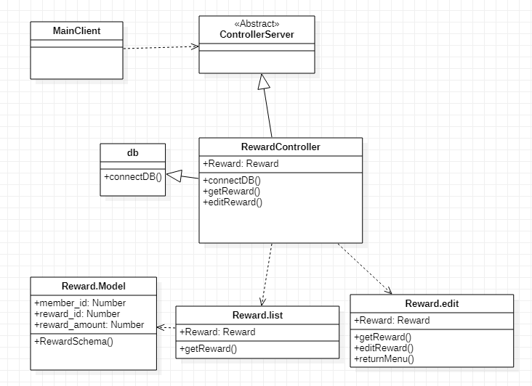
Reward Controller – Adapter pattern

Slide 13
Database Diagram

Slide 14
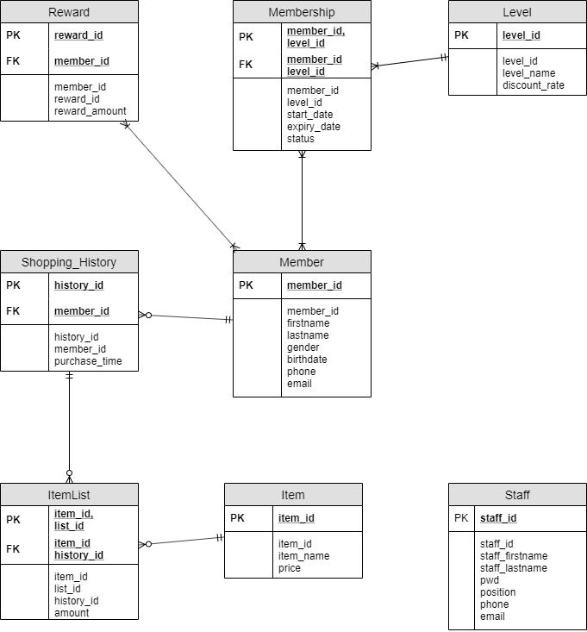

Slide 16
Improvements

Slide 17
The End

